Slide 1



MAHATMA GANDHI
NATIONAL RURAL EMPLOYMENT GUARANTEE SCHEME (NREGA)
Oluwatosin Joshua Adebayo

Slide 2

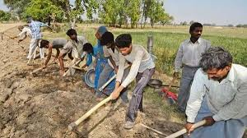

Overview
Introduction
01
About NREGA
02
Objectives
03
Problem Statement
04
Dataset Information
05
Analysis
06
Insights
07

Slide 3
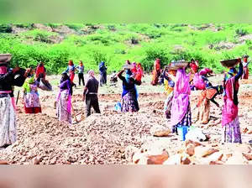
Introduction
NREGA is an Act to provide for the enhancement of livelihood security of the households in rural areas of the country by providing at least one hundred days of guaranteed wage employment in every financial year to every household whose adult members volunteer to do unskilled manual work and for matters connected therewith or incidental thereto.
This project delves into the analysis of Mahatma Gandhi National Rural Employment Guarantee Scheme (NREGA) Employment Data.

Slide 4
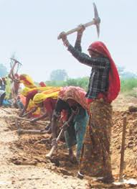
About NREGA
Mahatma Gandhi National Rural Employment Guarantee Act 2005 or MGNREGA, earlier known as the National Rural Employment Guarantee Act or NREGA, is an Indian social welfare measure that aims to guarantee the 'right to work'.
This act was passed on 23 August 2005 and was implemented in February 2006 under the UPA government of Prime Minister Manmohan Singh following tabling of the bill in parliament by the Minister for Rural Development Raghuvansh Prasad Singh.
It aims to enhance livelihood security in rural areas by providing at least 100 days of wage employment in a financial year to at least one member of every household whose adult members volunteer to do unskilled manual work.

Slide 5
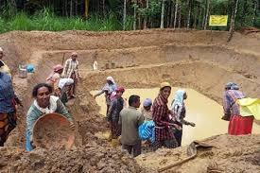

Objectives
We aim to gain valuable insights into the implementation and impact of NREGA across different states and districts in India.
Objective 01
Objective 02
Objective 03
This project delves into the analysis of data related to the National Rural Employment Guarantee Act (NREGA), a transformative government scheme aimed at providing rural households with guaranteed wage employment opportunities.
This project aims to analyze and visualize the NREGA dataset to extract meaningful insights
Drawing actionable insights to inform policymakers and administrators about the strengths and weaknesses of the NREGA program

Slide 6
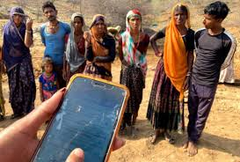
Problem Statement
NREGA is a vital initiative to alleviate rural unemployment and poverty. This project seeks to address several key questions and challenges associated with NREGA
What is the utilization of the allocated budget, and how does it correlate with employment generation?
Can data-driven insights guide policymakers and administrators in optimizing the scheme's impact?
How effective is NREGA in providing employment opportunities to rural households?
Are there regional disparities in the implementation and outcomes of the scheme?
What are the key factors contributing to the completion of NREGA works, and are there any roadblocks to its success?
Are there enough women representation?

Slide 7












Dataset Information
The dataset used for this analysis is sourced from official government records and contains information related to NREGA implementation across various states and districts in India. It comprises 28 columns, encompassing data on job cards, worker details, budget allocation, work completion statistics, expenditure, and more. This dataset offers a comprehensive view of the progress and challenges faced by the NREGA program.

Slide 8
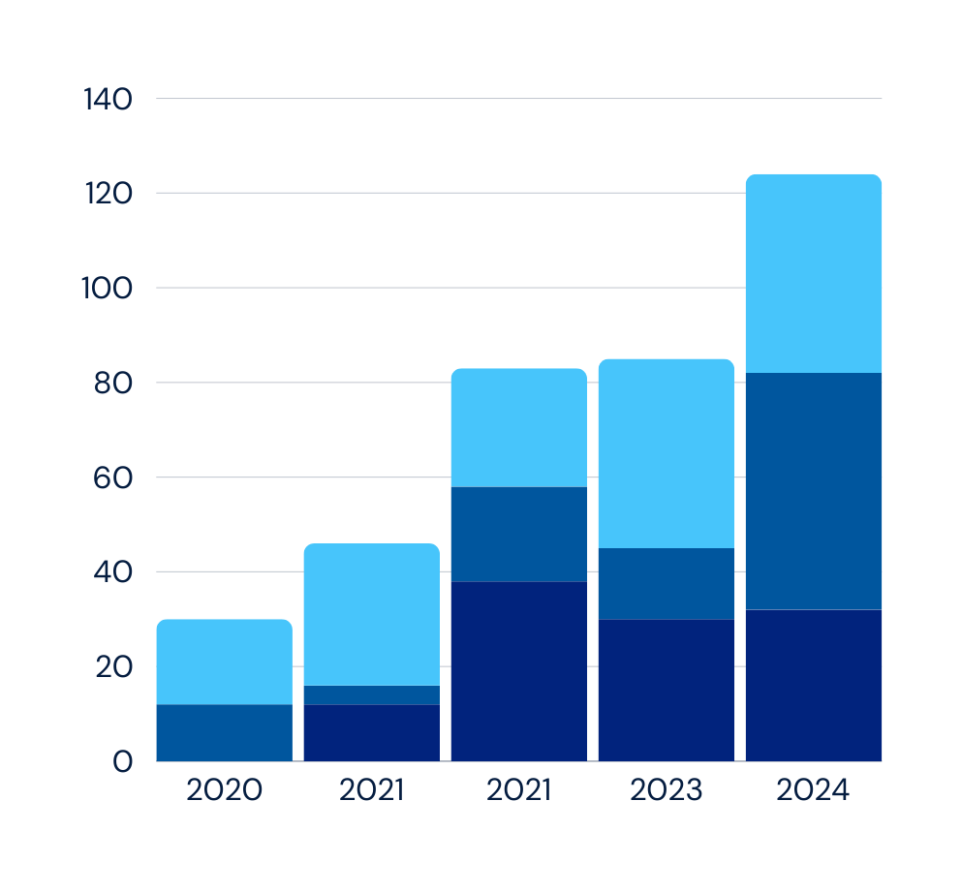
Analysis

Slide 9
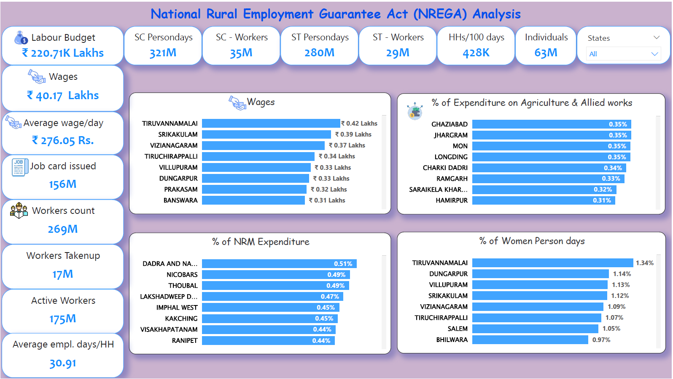

Slide 10
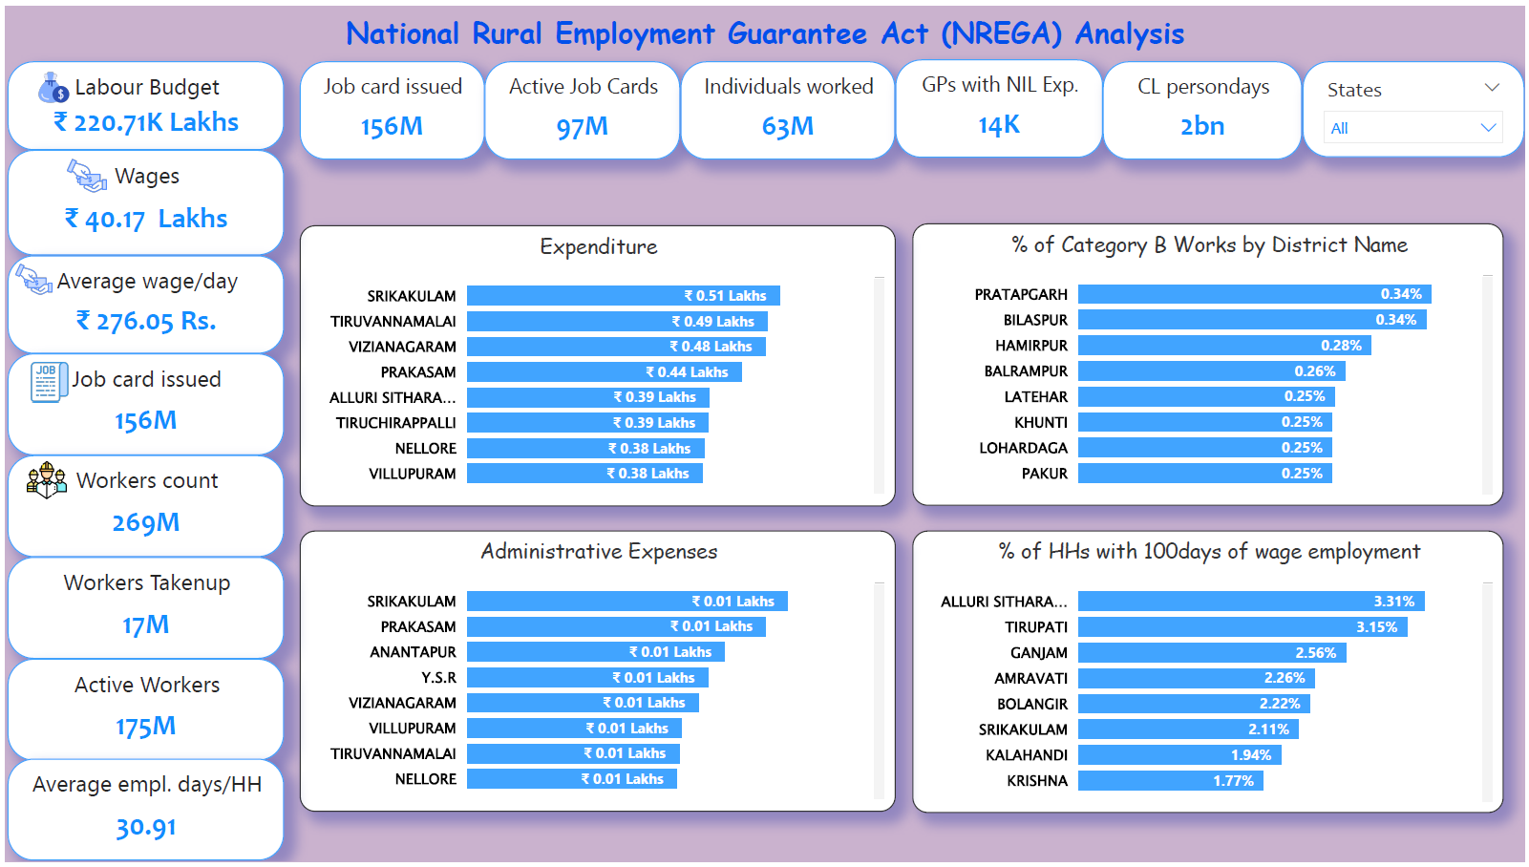

Slide 11
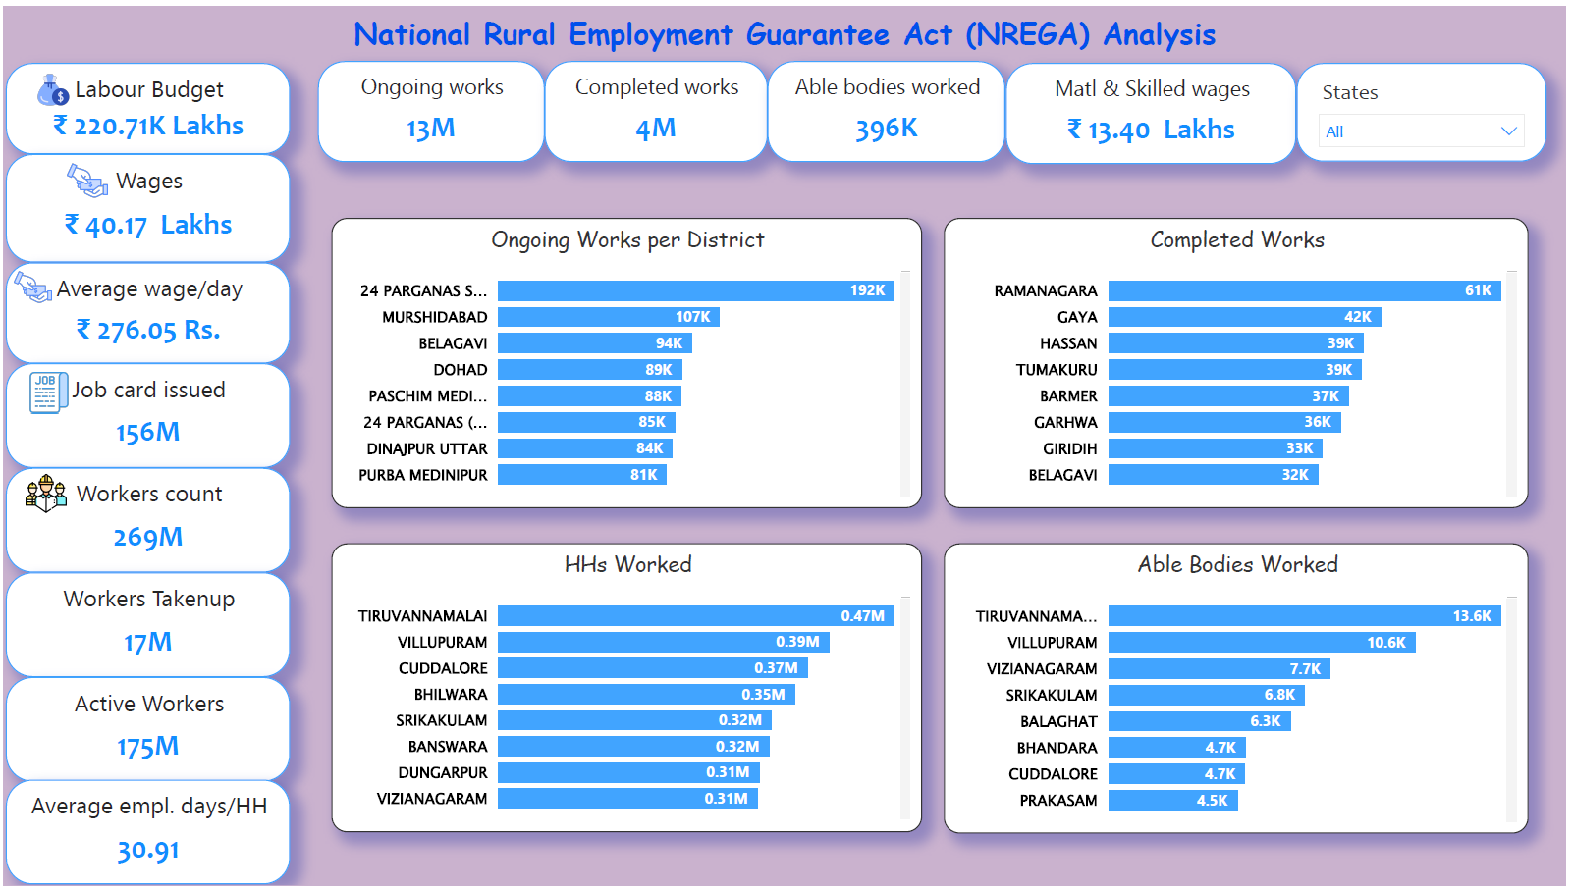

Slide 12
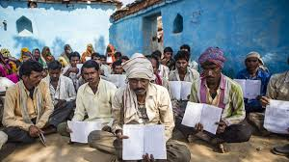
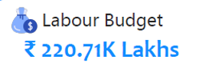

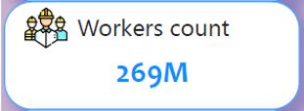
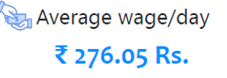
Insights
The program has empowered many unskilled laborers and has provided guaranteed employment.
Average wage rate meets up with the generic average wage per day in India

Slide 13
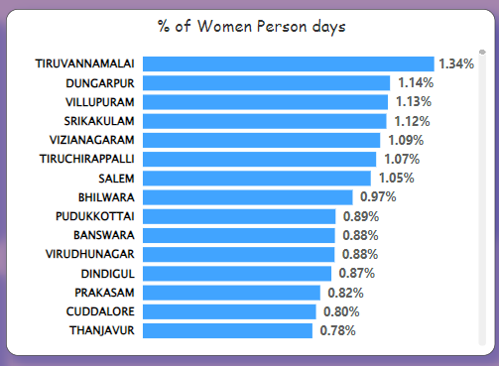
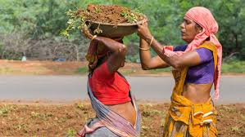
Insights
There have been women representation in the program (979M person days) so far. This shows guaranteed employment for women in unskilled labor except Lakshadweep and DN Haveli with 495 & & 7 women person days respectively
Districts with the highest percentage of women person days

Slide 14
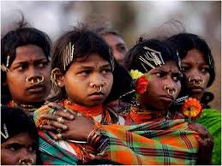
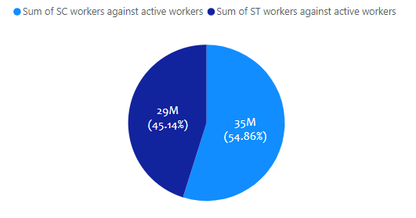
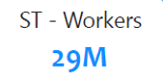
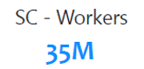
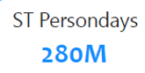
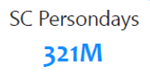
Insights
Scheduled Caste and Scheduled Tribes workers against active workers.
It has empowered the socio-economic deprived people by law the right to work.

Slide 15
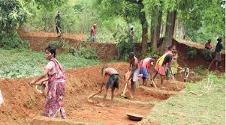
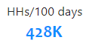
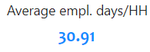
Insights
With over 170M active workers, data shows that the average employee days is approximately 31 days per household with only 428,000 Household able to complete the stipulated 100days of wage employment per household.
This shows that there is need for more households to activate their right to work and be engaged to work.

Slide 16
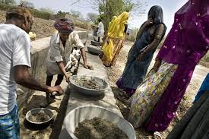
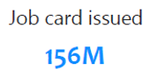
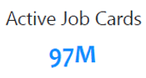
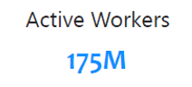
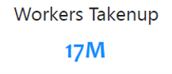
Insights

Slide 17
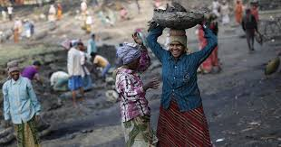
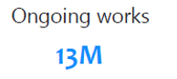
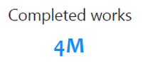
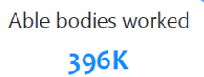
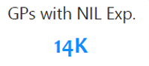
Insights

Slide 18
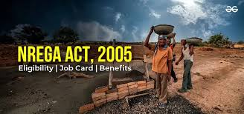
Insights
Recommendation
More representation of workers needed across board and in every household eligible to work.
More socio-economic deprived workers need to be engaged and protected under the right to work Act.

Slide 19

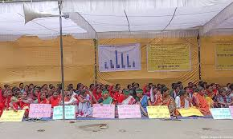



THANK YOU!
Oluwatosin Joshua Adebayo
Analyst
ayojoshua01@gmail.com

